Slide 1
Output 1:
Clinical case 2

Slide 3
Design CAD/CAM Insole
3D Foot Scan
Plantar Pressure
Measurement
2D Foot Scan
3D Gait Analysis
2D Gait Analysis
3D
Insole
OR

Slide 4
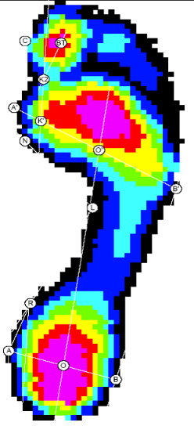
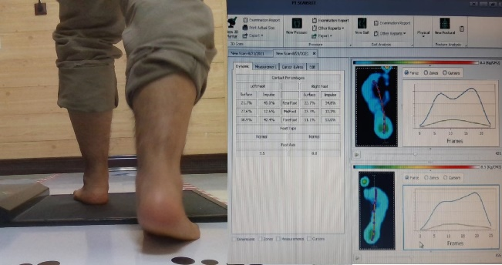
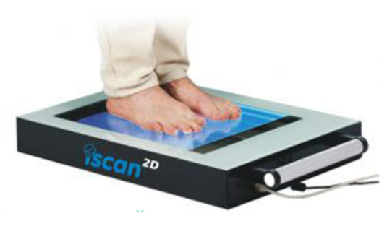
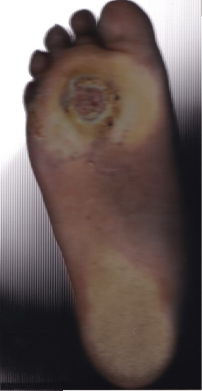
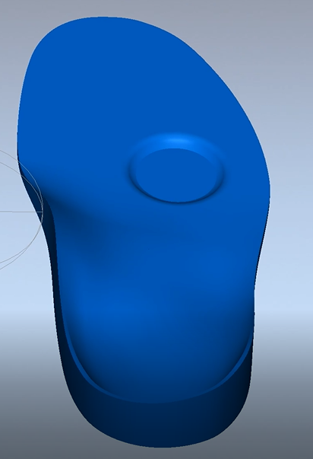
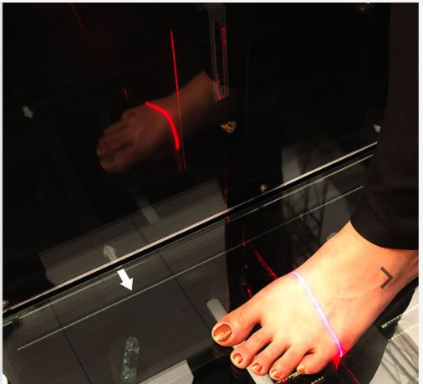
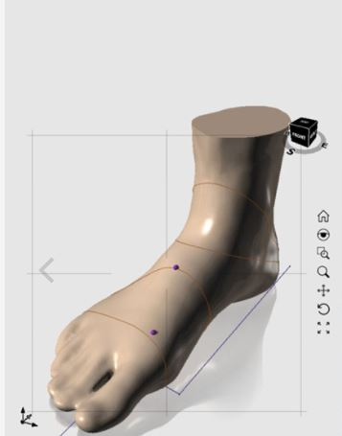
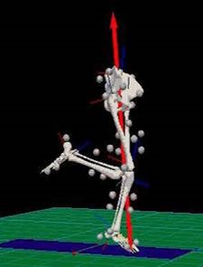
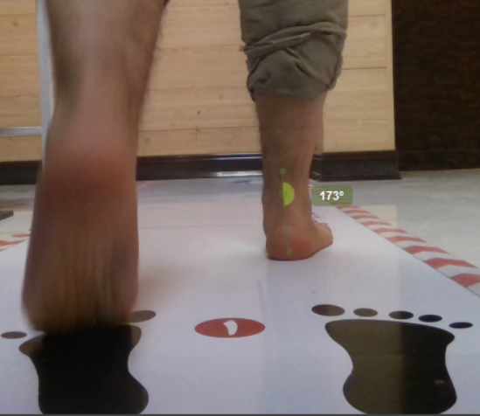
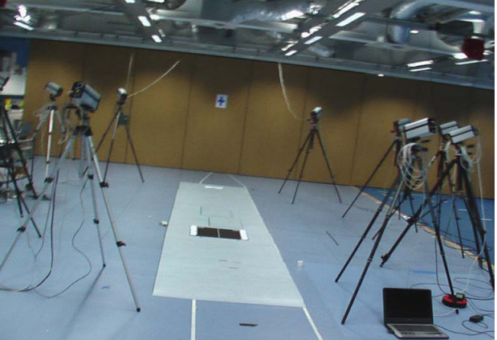
Design CAD/CAM Insole
3D
Insole
OR

Slide 5
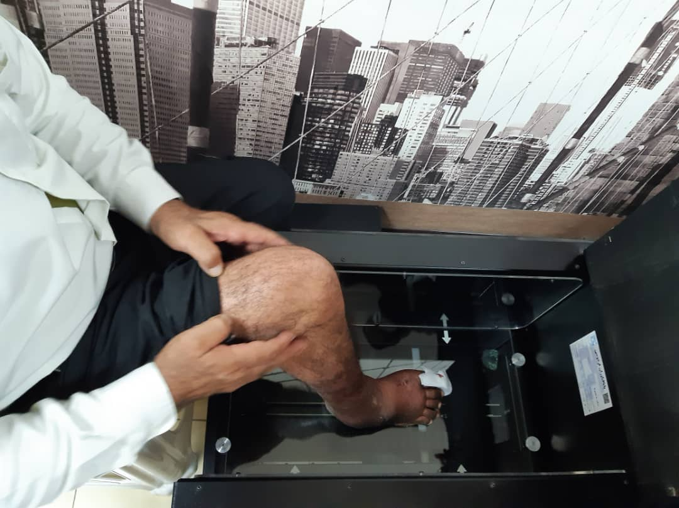
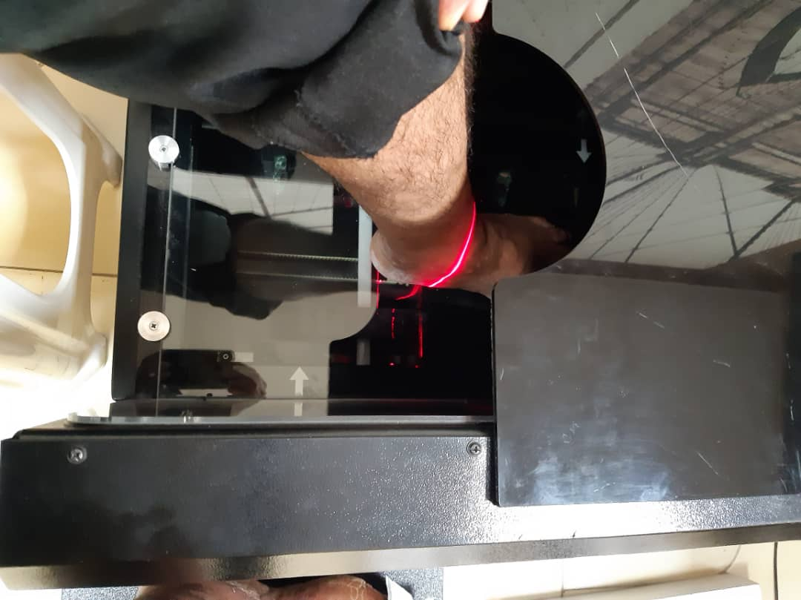
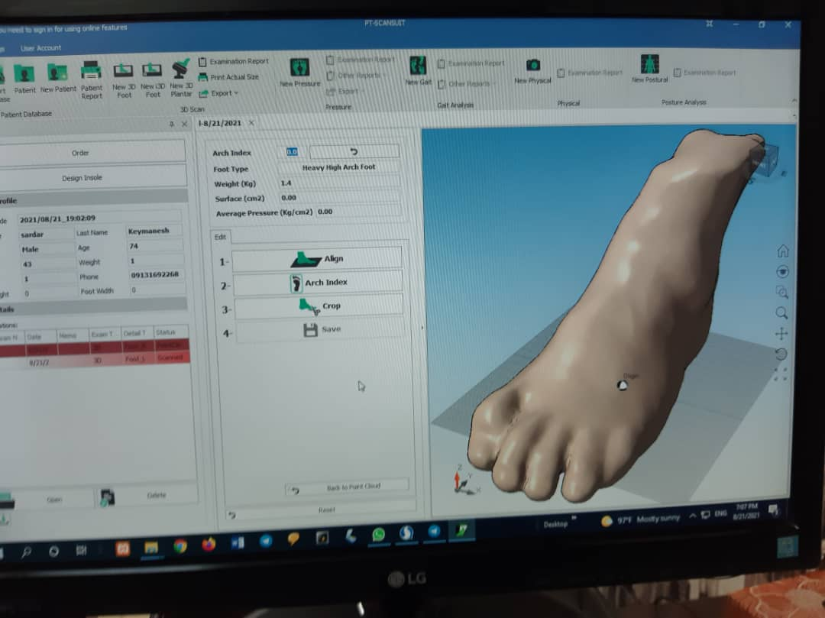
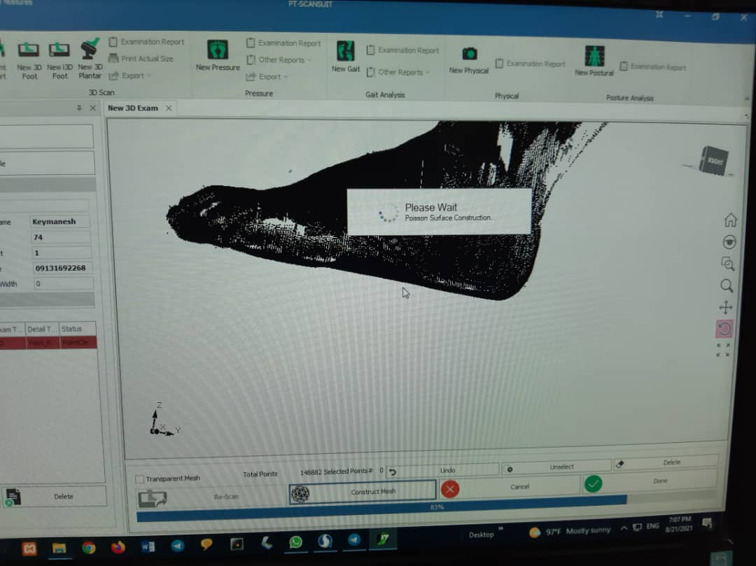
3D Foot Scan
Digitize the exact 3D shape of foot

Slide 6
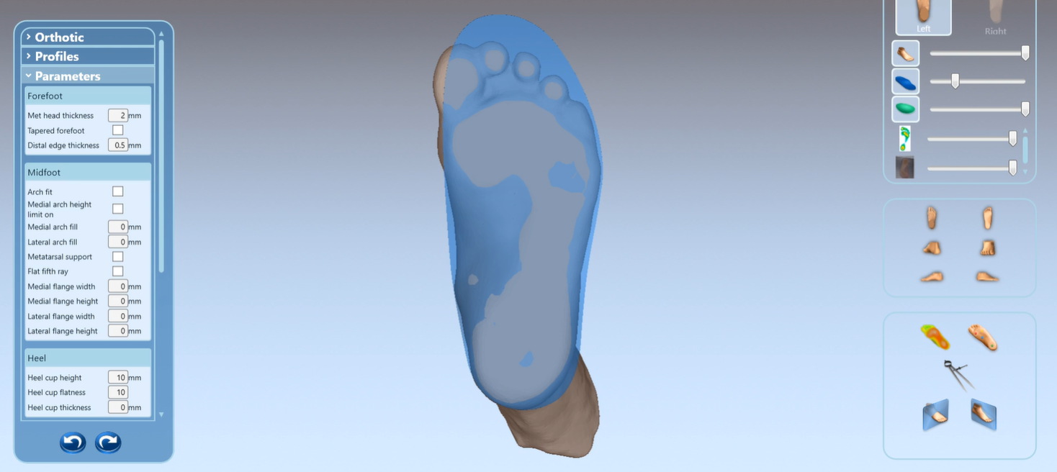
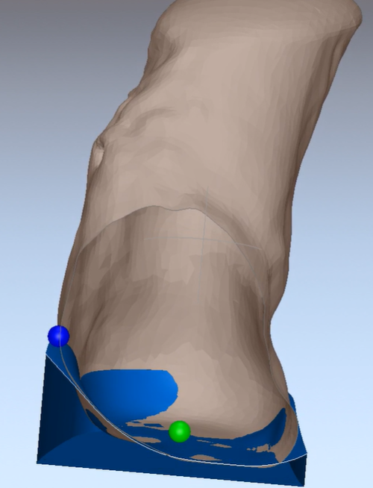
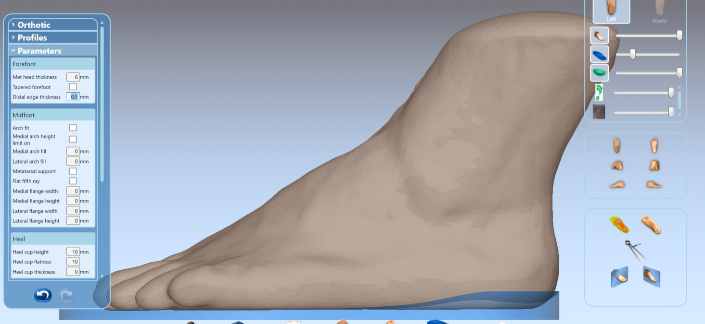
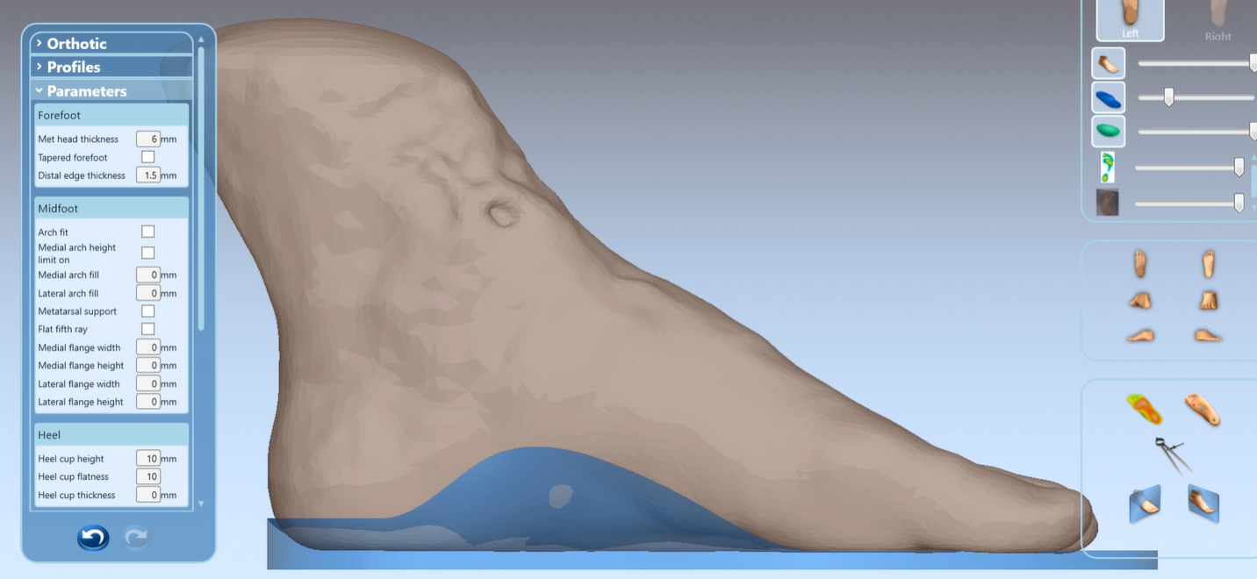
Custom insoles with a personalized 3D shape
3D CAD insoles manufactured on such a way:
To match each foot geometry for a truly customized support.
Up to100% tailored to your right and left feet
Naturally supporting each contour of your foot

Slide 7
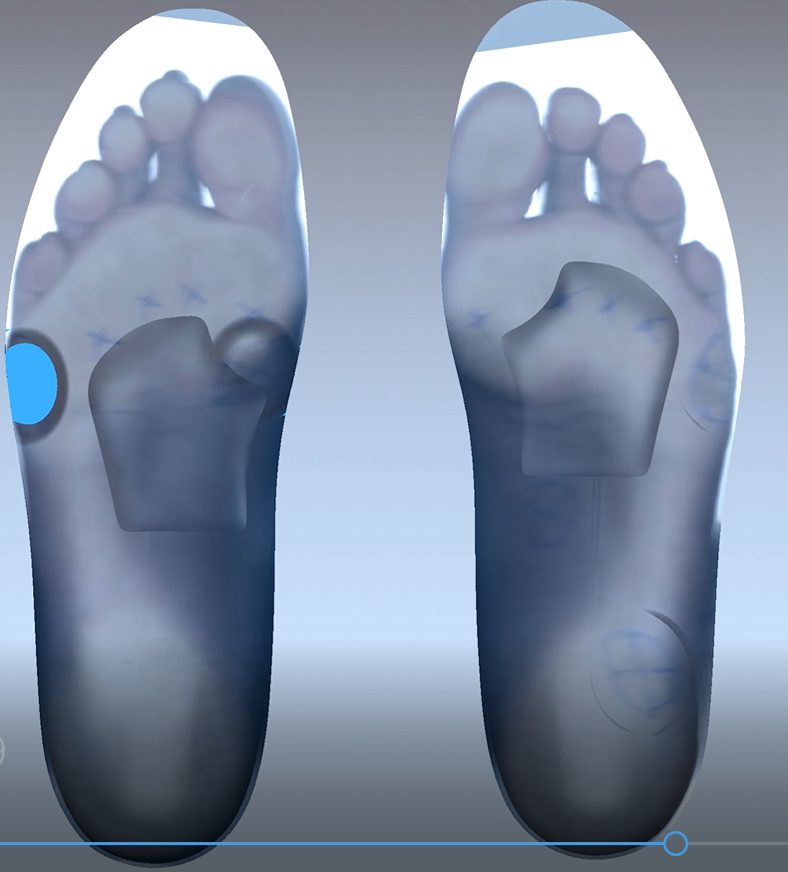
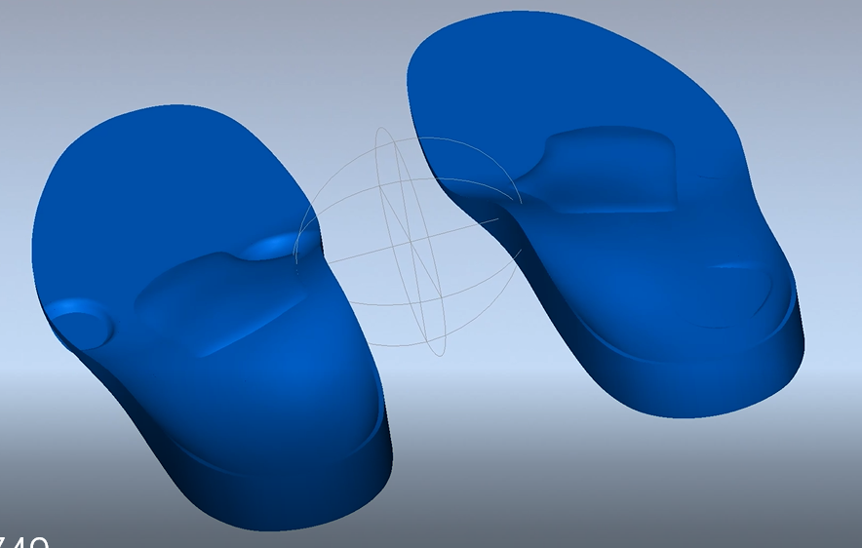
2D Foot Scan
Digital photography data taken from the weight-bearing surfaces of feet while standing will be integrated with 3D shape data in the process of design mainly for an indication of foot size, and also for making corrections in design process according to the plantar skin conditions.

Slide 8
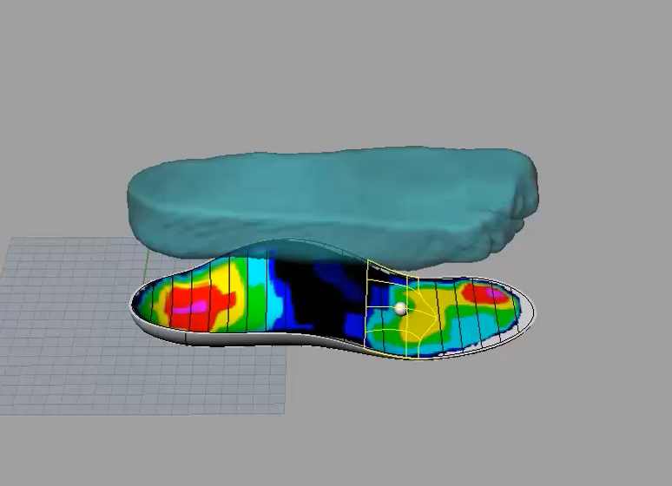
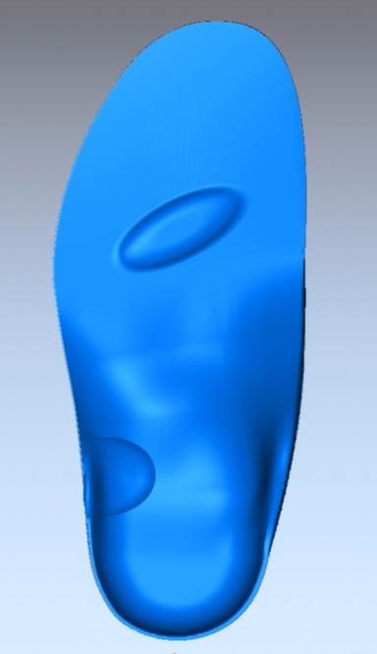
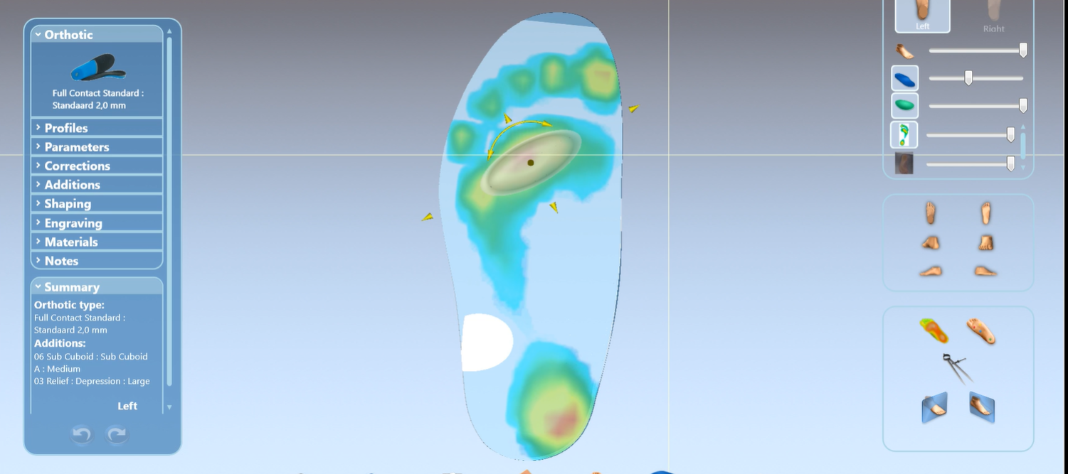
Plantar Pressure Data Offloading
Pressure data taken from the weight-bearing surfaces of feet while standing and walking will be integrated with 3D shape data in the process of design mainly for offloading and padding.

Slide 9
Plantar Pressure Data Padding

Slide 10
3D OR 2D Gait Analysis
Data driven from high-tech 3D or 2D Gait analysis describing the movements of your foot and ankle joints can be used in the Process of insole design
PLEASE SEE NEXT SLIDE
For example we found that we have 5 degrees abnormal Rearfoot Inversion

Slide 11
Using data from high-tech 3D or 2D Gait analysis in the process of design
10 degrees Rearfoot Lateral Wedge

Slide 12
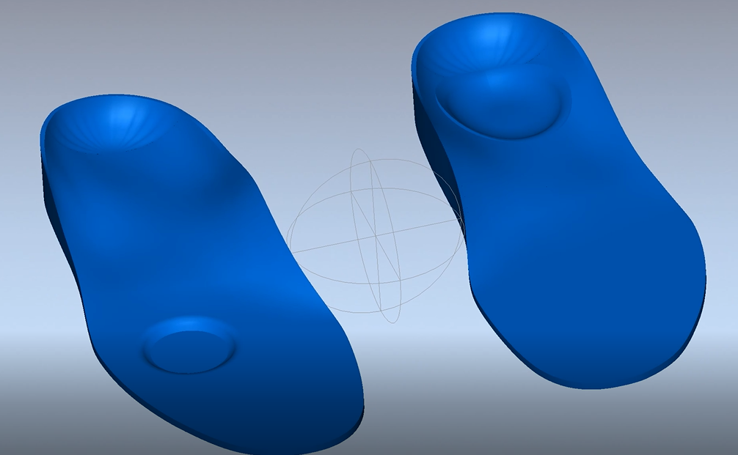
Final Product

